Slide 2
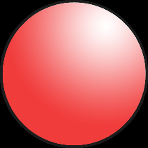
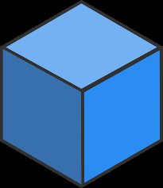
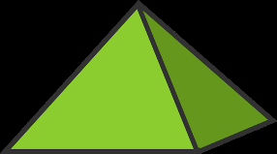
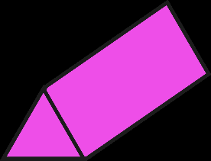
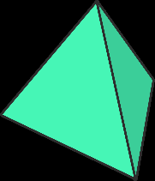
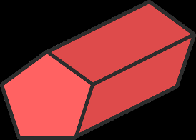
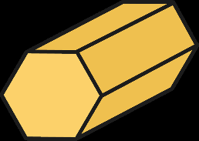
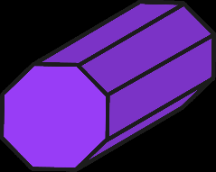
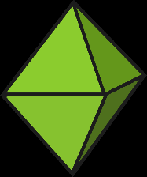
Guess the 3D Object
?
?
?
?
sphere
cube
rectangular prism
pyramid
?
?
?
?
cylinder
cone
triangular prism
tetrahedron
?
?
?
?
pentagonal prism
hexagonal prism
octagonal prism
octahedron

Slide 3
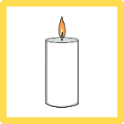
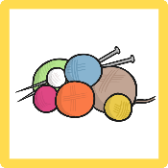
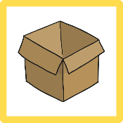
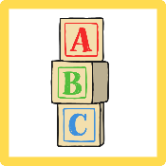
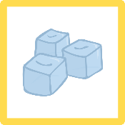
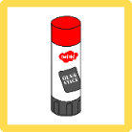
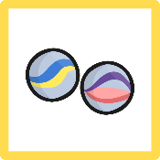
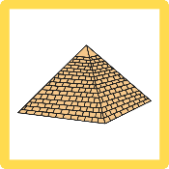
Sort the Objects
cube | rectangular prism | sphere
cylinder | square-based pyramid | cone

Slide 4
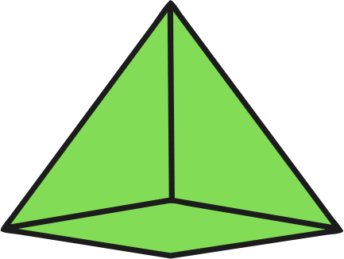
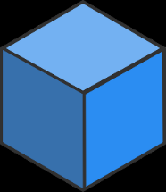
Object Properties
square-based
pyramid
faces =
5
edges =
vertices =
8
5
cube
faces =
6
edges =
12
vertices =
8
rectangular
prism
faces =
6
edges =
12
vertices =
8
faces =
1
edges =
0
vertices =
0
cone
curved surface = 1
1
Hide answers
Show answers

Slide 5
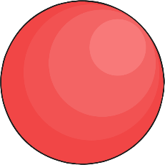
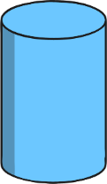
Object Properties
faces =
0
edges =
0
vertices =
0
sphere
curved surface = 1
1
faces =
2
edges =
2
0
vertices =
cylinder
curved surface = 1
1
triangular
prism
faces =
5
edges =
9
vertices =
6
tetrahedron
faces =
4
edges =
6
4
vertices =
Show answers
Hide answers

Slide 6
Sort the Objects
cylinder | rectangular prism | cone | pyramid | cube
Photos courtesy of ~Brenda-Starr~, The Pink Princess, vwb5, Squire Morley, matsuyuki, Kyle May, kevinpoh, RNW.org, infomatique and dno1967b (@flickr.com) - granted under creative commons licence – attribution

