Slide 2
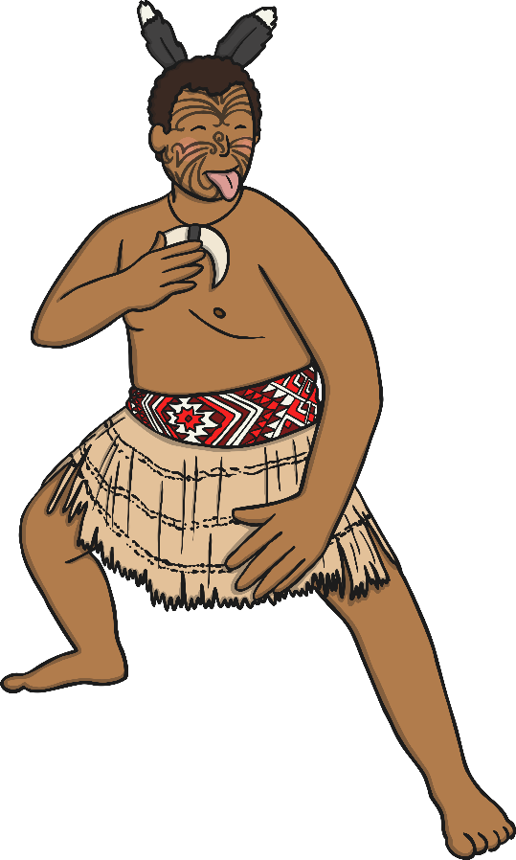
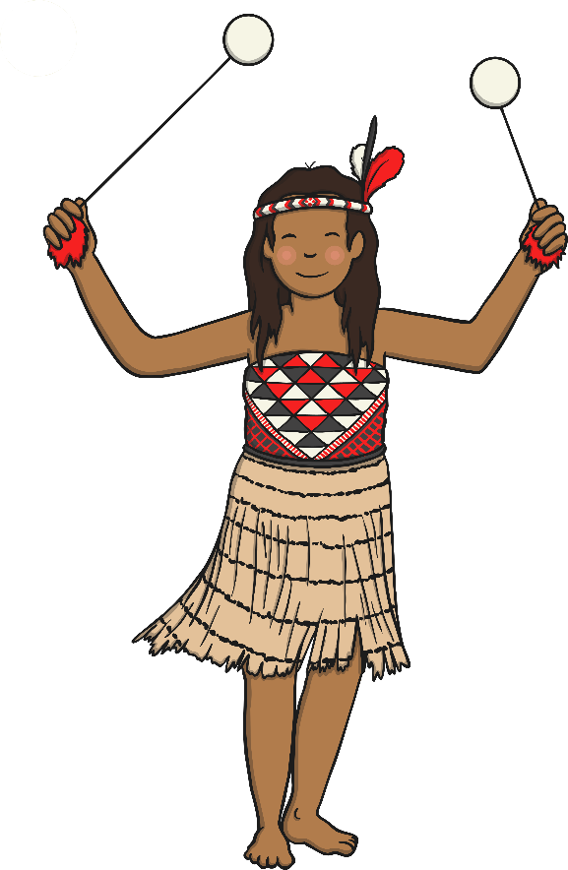
What is Matariki?
Matariki is one of the most important Māori celebrations.
Matariki is a celebration of people, culture, language, spirituality and history. Matariki is the Māori New Year.
Matariki can be translated as:
Mata Riki – Tiny Eyes or Mata Ariki – the Eyes of God.

Slide 3
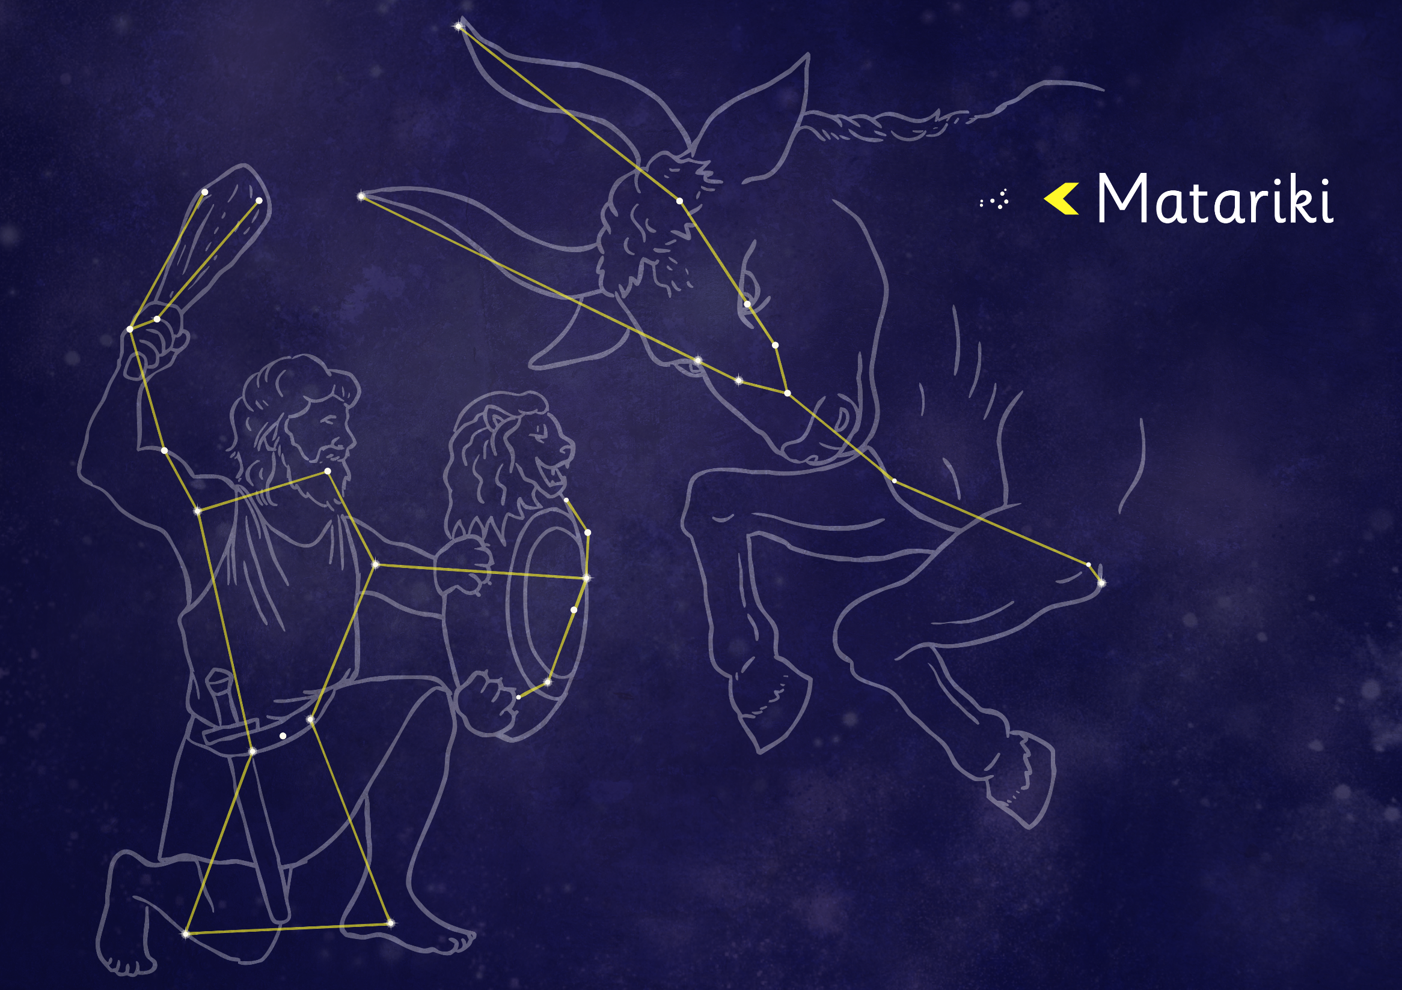
Te Kāhui o Matariki
Matariki is the Māori name for a cluster of stars.
Matariki is known in other parts of the world as Pleiades, Subaru, Seven Sisters and Messier 45.
Matariki is the shoulder of Taurus the bull, a constellation of stars.

Slide 4
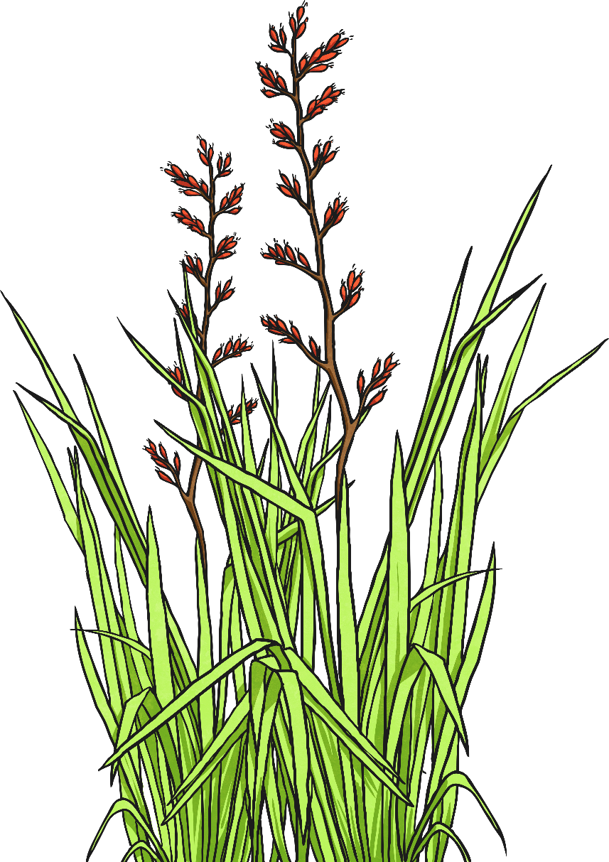
Te Kāhui o Matariki
Before Māori had calendars, they tracked time using events that happened in the natural world, such as the flowering of plants or the movement of stars in the sky.

Slide 5
Te Kāhui o Matariki
Matariki reappears in the north eastern pre-dawn sky in late May or early June. This is the Maori New Year and it is a sign of a change in season in to winter.
There are different names for each of the Matariki stars. These vary between tribes. The following are the names commonly used:
The brightest star is also known as Matariki (Alcyone).

Slide 6
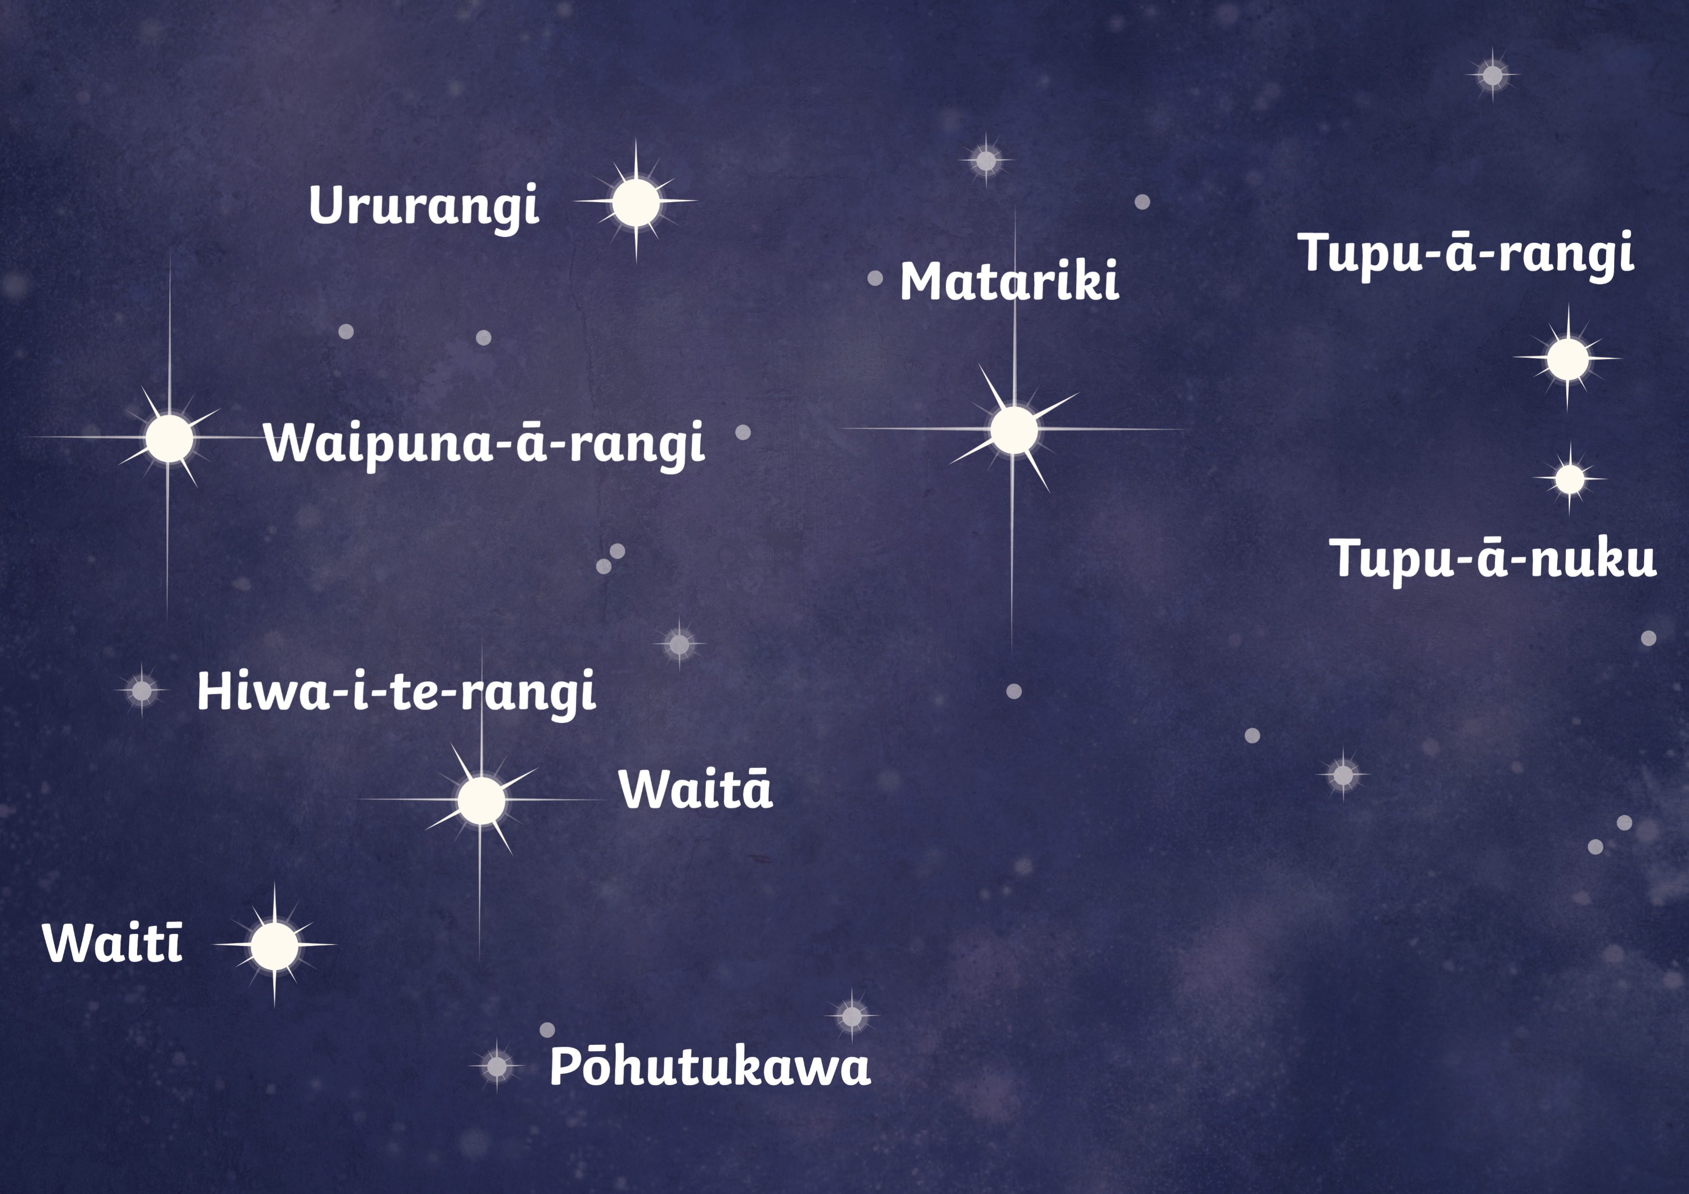
Te Kāhui o Matariki
The other eight stars are:
Tupu-ā-rangi
(Electra)
Waipuna-ā-rangi
(Taygeta)
Waitī
(Maia)
Ururangi
(Pleione)
Tupu-ā-nuku
(Atlas)
Waitā
(Merope)
Hiwa-i-te-rangi (Celaeno)
Pōhutukawa (Sterope/
Asterope)
Māori believed that if the stars in the cluster were clear and bright, then it would be a warm season with a lot of food. If Matariki looked hazy or shimmering, then it would be a cold and difficult season.

Slide 7
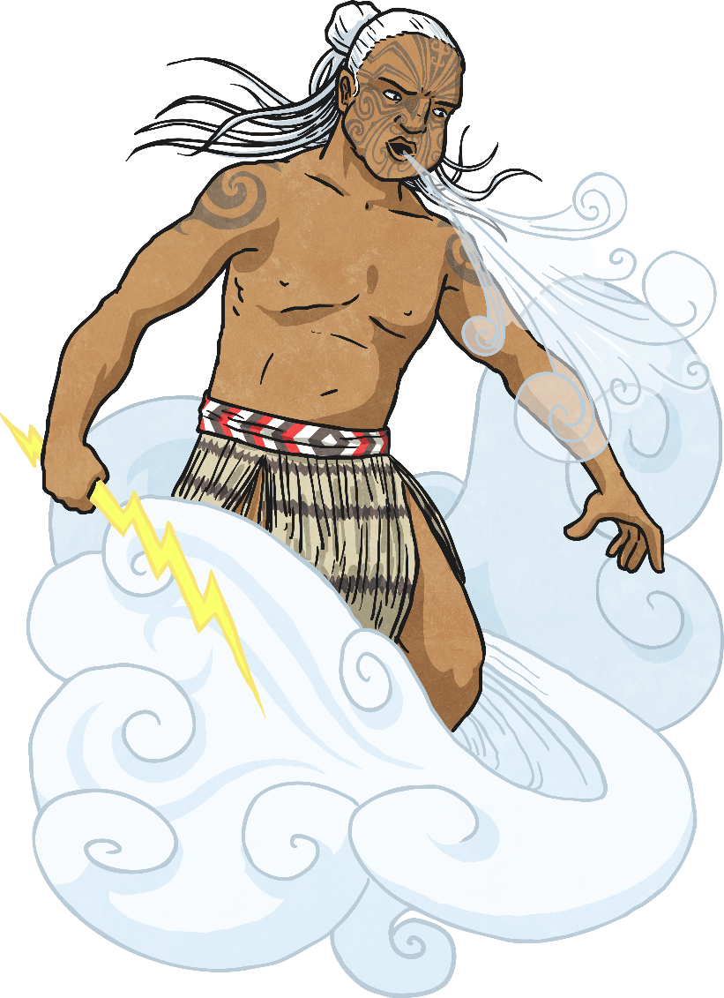
Māori Pūrākau
There are many myths and legends that relate to Matariki.
One tells of Tāwhirimātea, the God of Wind, getting so angry that he throws his eyes into the sky.

Slide 8
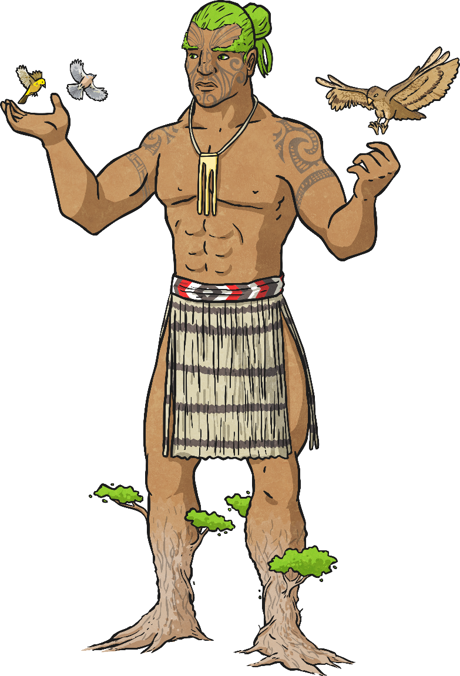
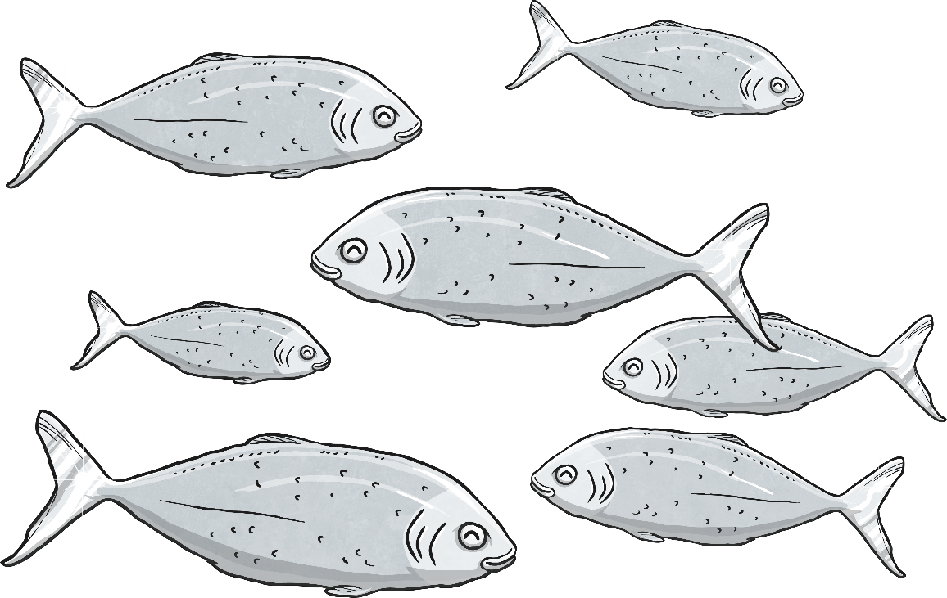
Māori Pūrākau
Another is about a mean fisherman that captures 7 fish. Tāne - the God of Light - rescues them, throwing them into the sky where they become stars.
Some also believe that Matariki is a mother star surrounded by her six daughters.

Slide 9
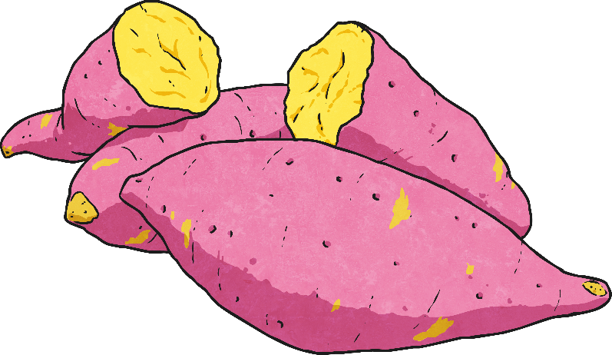
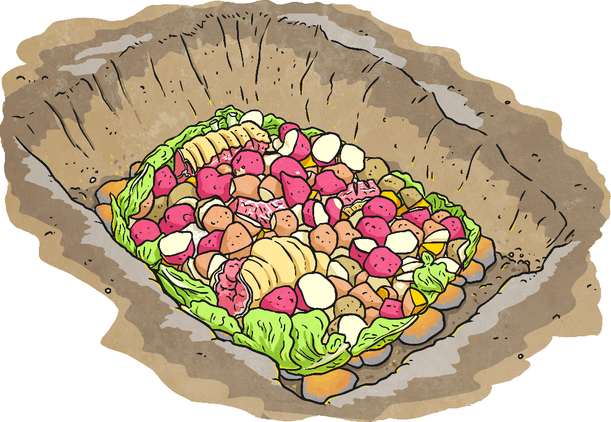
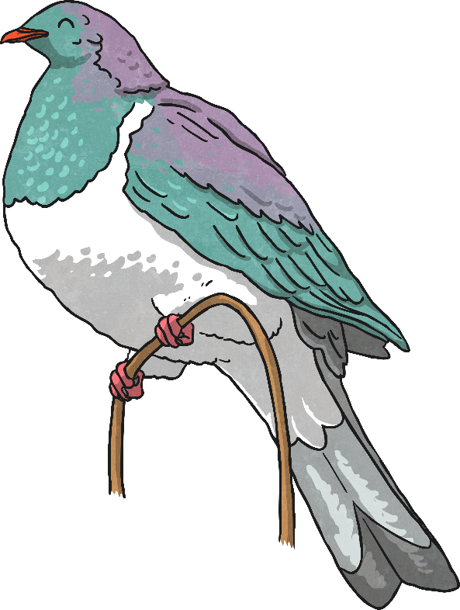
How was Matariki Celebrated?
Matariki was celebrated at the end of the harvest season. It was a time when the pātaka kai (storage house) was full of food. There was kūmara, kererū and fish such as moki and korokoro.
During the celebration, there were big Hākari (feasts).

Slide 10
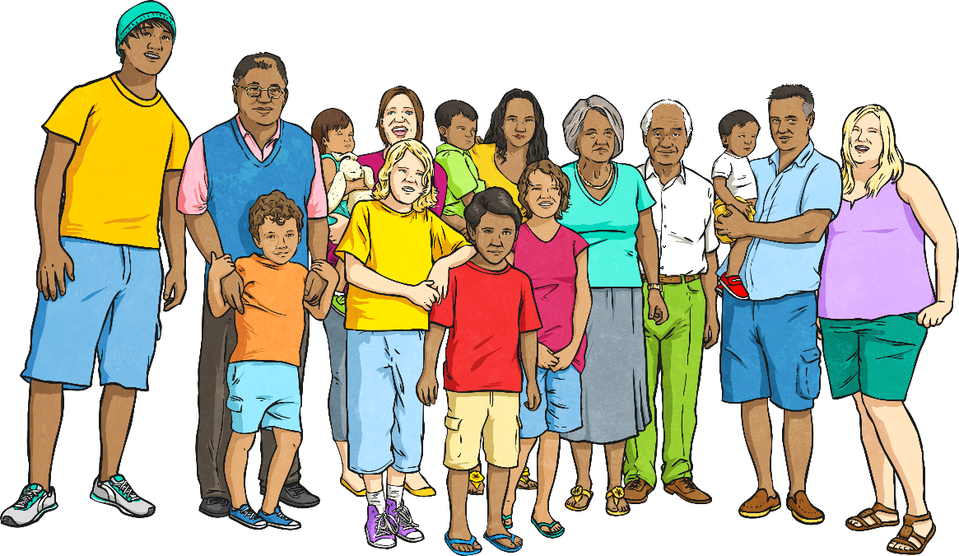
How was Matariki Celebrated?
People came together to remember the past, their ancestors and to learn about their whakapapa (ancestry).
Māori would plan for the future and prepare the whenua (land) for planting.
Whānau (family) would come together and share songs, traditions and stories.

Slide 11
How is Matariki Celebrated Now?
Matariki is now a time to celebrate Aotearoa and everything Māori. We can learn about our land and our whakapapa (ancestry).
Matariki is celebrated through education, remembrance and the planting of new trees and crops. It is a sign of new beginnings.
Lots of celebrations focus on music, songs, dance,
food and family.

Slide 12
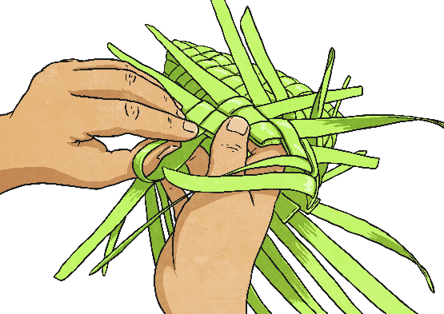
How is Matariki Celebrated Now?
You can celebrate in traditional Māori ways or choose your own way to celebrate. You could:
Try some Māori arts or crafts
Set new goals for the future
Have a hāngī
Learn some new songs or dances

Slide 13
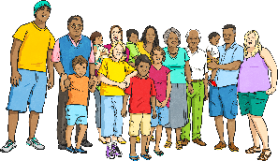
How is Matariki Celebrated Now?
Learn about Māori pūrākau and pakiwaitara
Learn
about stars
and their constellations
Hold a whanau (family) day
Plant vegetables

Slide 14
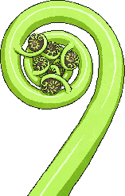
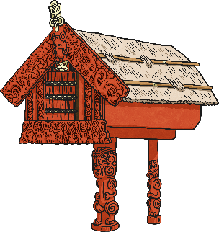
How is Matariki Celebrated Now?
Have a school performance
Learn about how Matariki is celebrated on other Pacific Islands
Learn about harvesting crops
Learn about your whakapapa and complete a family tree

